Slide 1
Big Mountain Resort Report
By: Joe Anson Aquino

Slide 2
Problem
Big Mountain Resort is in need of a new pricing strategy, a pricing model that can determine a price that is competitive for customers as well as Big Mountain Resorts facilities.
Current Price: $81.00 / Adult

Slide 3
Recommendation and Key Findings
Ticket prices be raised to $89.99.
4-6 runs should be closed each day to reduce operation costs.
Lower a run by 150 feet, and install an additional chair lift.
Add another Run, and you can increase the amount of snow cover by two acres.
Based on the model, an increase of $2 in ticket prices would increase revenue by $3.464.638.

Slide 4
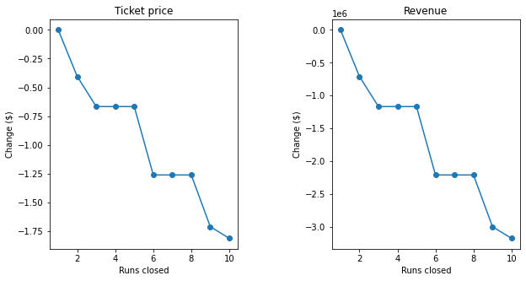
Modeling result and Analysis
SCENARIO: No.1
Permanently closing down up to 10 of the least used runs. This doesn't impact any other resort statistics.
The model says closing one run makes no difference. Closing 2 and 3 successively reduces support for ticket price and so revenue. If Big Mountain closes down 3 runs, it seems they may as well close down 4 or 5 as there's no further loss in ticket price. Increasing the closures down to 6 or more leads to a large drop.
SCENARIO: N0.2
Increase the vertical drop by adding a run to a point 150 feet lower down but requiring the installation of an additional chair lift to bring skiers back up, without additional snow making coverage
This scenario increases support for ticket price by $1.99
Over the season, this could be expected to amount to $3474638

Slide 5
Modeling result and Analysis
SCENARIO: N0.3
Same as number 2, but adding 2 acres of snow making cover
This scenario increases support for ticket price by $1.99
Over the season, this could be expected to amount to $3474638
~ Such a small increase in the snow making area makes no difference! ~
SCENARIO: N0.4
Increase the longest run by 0.2 mile to boast 3.5 miles length, requiring an additional snow making coverage of 4 acres
No difference whatsoever. Although the longest run feature was used in the linear model, the random forest model (the one we chose because of its better performance) only has longest run way down in the feature importance list.

Slide 6
Summary and conclusion
With many significant amenities and attractions, Big Mountain Resort is a high end resort. As long as you continue to offer high quality amenities, like the new chair lift, you can justify raising the price
In addition to covering operations costs, there is plenty of room for revenue growth.
It is likely that Big Mountain Resort will remain open for many more years with any of these recommendations

